Slide 1
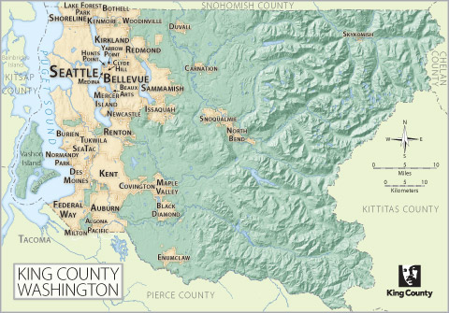
Linear Regression Modeling King’s County Housing

Slide 2
The Data
Target:
Goal is to predict: House Price
Predictor Variables:
Number of Bedrooms, Bathrooms, and Floors
Sq. footage – Internal and Lot
Overall Condition (1-5)
Geographical Location (Based on Clustering)
Waterfront (yes / no)
Year Built
Renovated (yes / no)

Slide 3
DATA
Feature Engineering
Build Model
Deploy!
Test
Model
Bad Results
Good Results

Slide 4
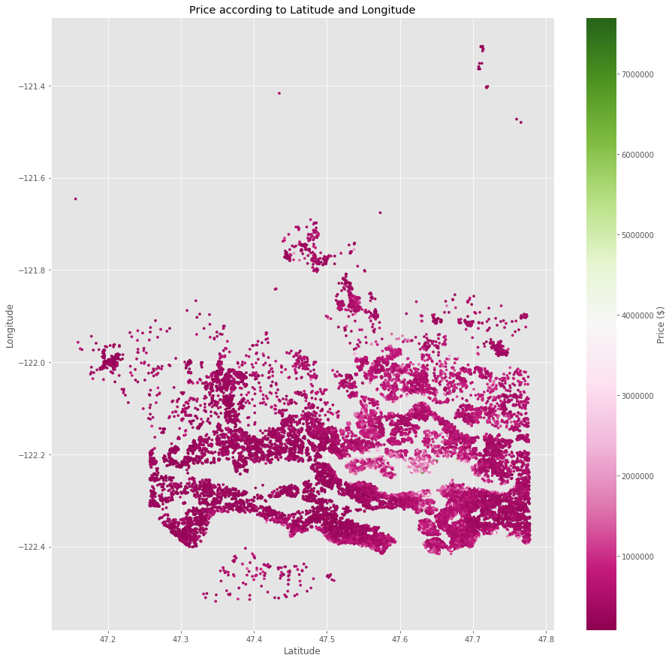
Problem: Dealing with Location Data
Price depends on exact location
Difficult to use latitude, longitude, zip code in linear model
Still want to capture affect of location in model

Slide 5
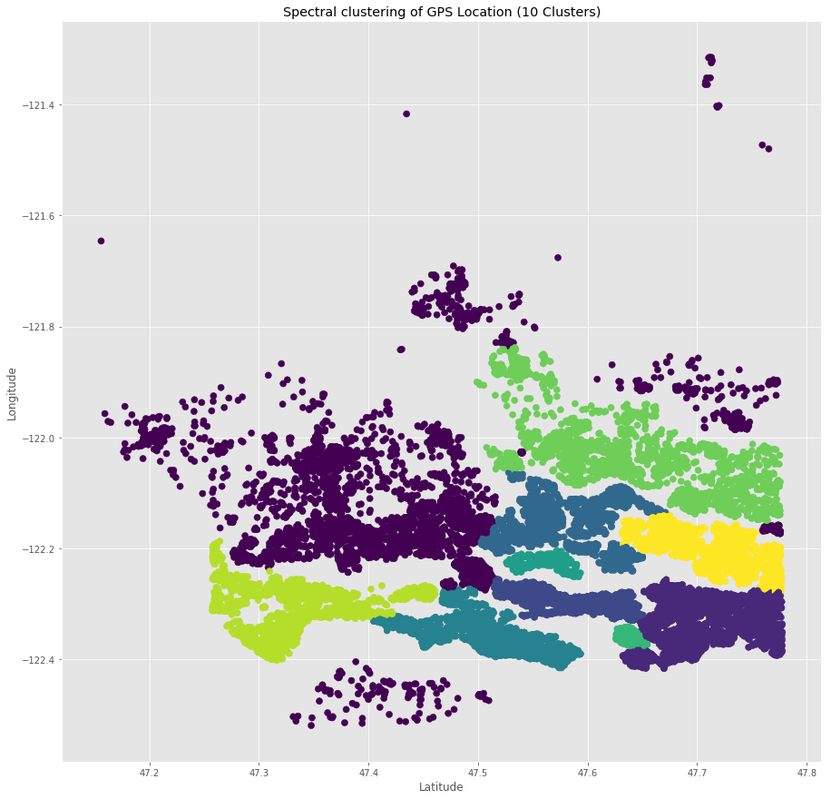
Solution: Spectral Clustering
Finds patterns in data and separates into groups
Works well with complicated patterns
Gives good way to distinguish geographical affect of price
Works well in linear model
Extracts meaning from location data

Slide 6
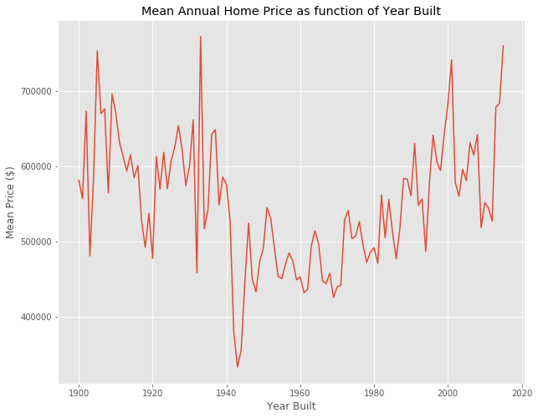
Problem: Dealing with time series data
Year built has clear affect on price
Won’t work well in linear model
Still want to capture affects in linear model

Slide 7
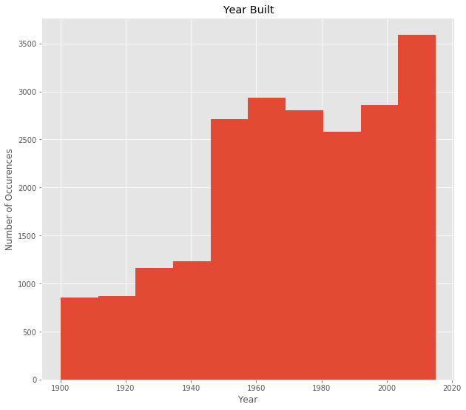
Solution: Binning
Reduce complexity: Keep only which decade house belongs to
Create new features representing each bin
Linear model captures time affect – Performs better

Slide 8
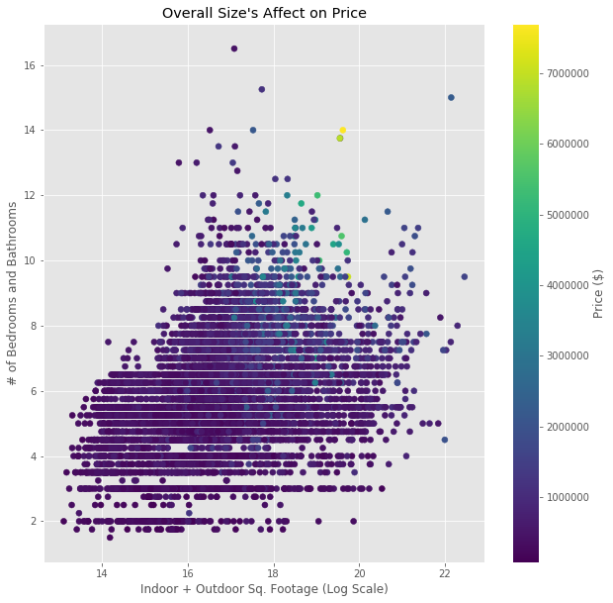
The Model
Best Features:
Number of Total Rooms & Floors
Indoor Sq. Footage
Overall Condition
Location
Year Built
Achieved R^2 Score of
~0.76 on Test Set
~0.77 on Training Set
Results:
Housing prices are volatile, so these results are good for a linear model
(See how spread out visual is)

Slide 9
Recommendations – Feature Engineering
~17% R2 improvement
All features = statistically significant
Performs best on new data
Recommendation: Use model in production

Slide 10
Recommendations – Key Value Drivers
More expensive homes:
Large square footage
Waterfront
Built past 2009 or from 1900 – 1920
Top condition
Premium Location (i.e. zipcode 98102)

Slide 11
Recommendations – Things to watch for
Most expensive homes = most difficult to predict
Location is everything
Identical homes + different neighborhood
⬄ Completely Different Price!
# of Rooms less important than sq. footage
Renovation works
Home in poor condition
Built in 70s – 90s

Slide 12
Recommendations: Improvements
More Data about location:
Nearby Education
Parks & Facilities
Crime rate
Avg. age
…

